Slide 1
Forest Cover Loss and Emissions

Slide 2
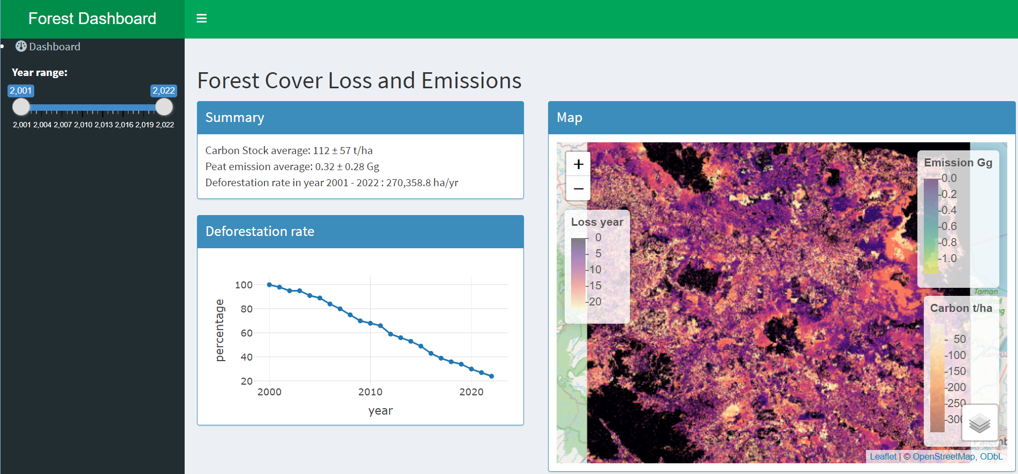
Forest cover loss year
The forest loss year raster map contains the values from 1 to 22 representing the year 2001 to 2022. The value 2001 means that the forest cover was lost in 2001. The value 0 means that the forest area has not lost since 2000 or has been lost before 2000.

Slide 3
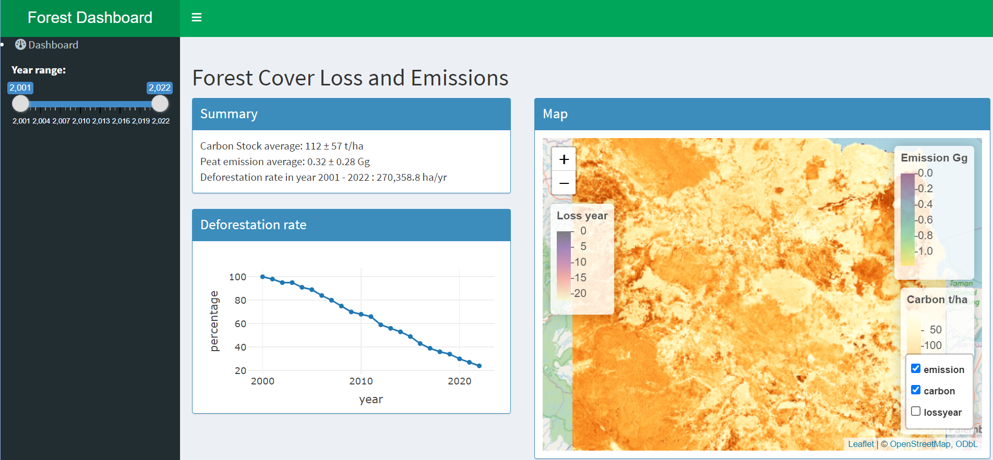
Forest carbon stock
The carbon stock data presents the carbon stock density in tonne carbon per hectare. The carbon stock density average and standard deviation was 112 ± 57 t/ha. The denser carbon stock was found in the mountainous area on the west side.

Slide 4
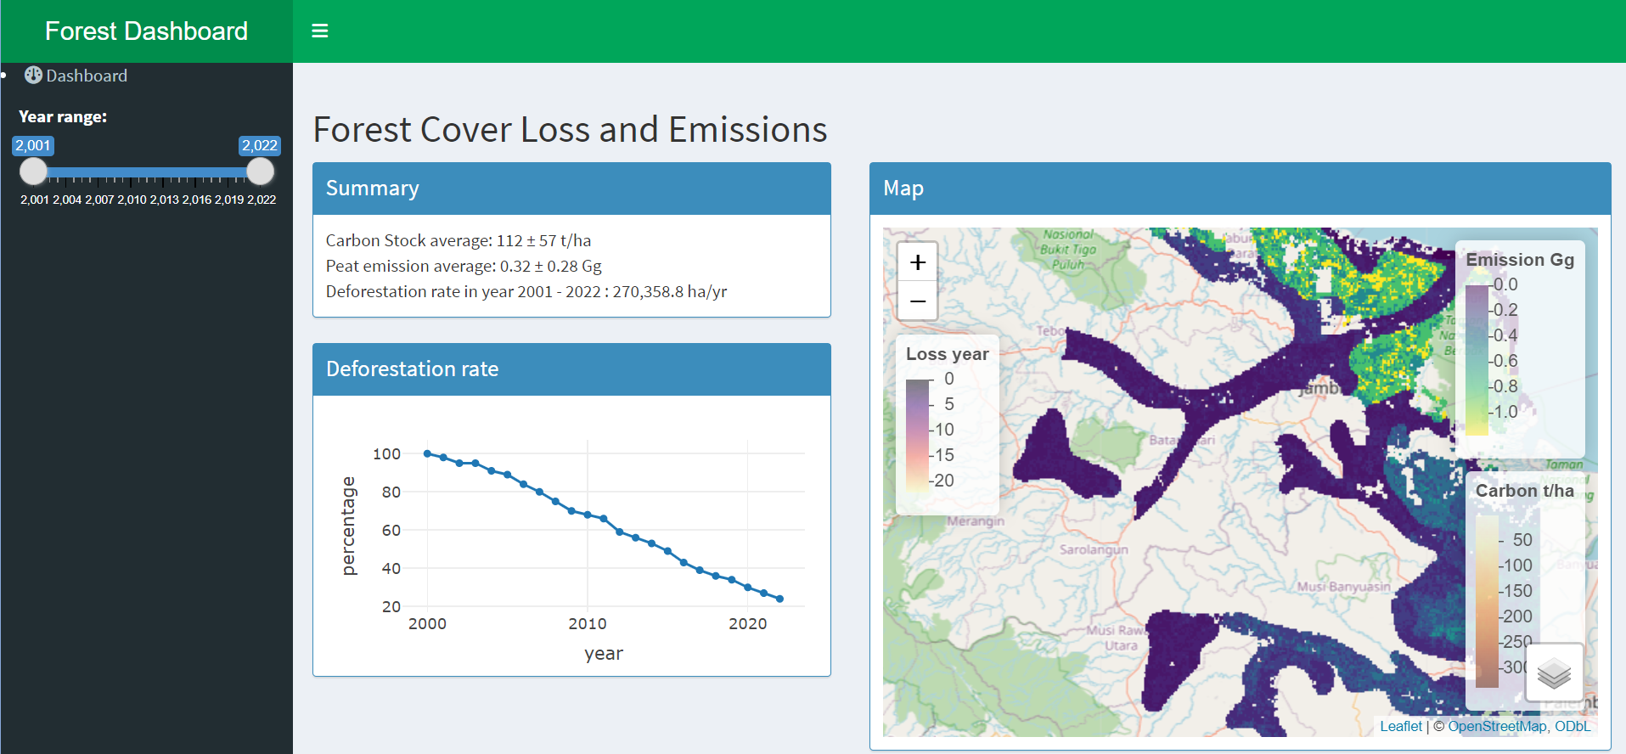
Peat carbon emission
The annual peat carbon emission is presented in the Gigagram unit. It only shows the emission of cropland in peatland areas. The emissions average and standard deviation was 0.32 ± 0.28 Gg.

Slide 5
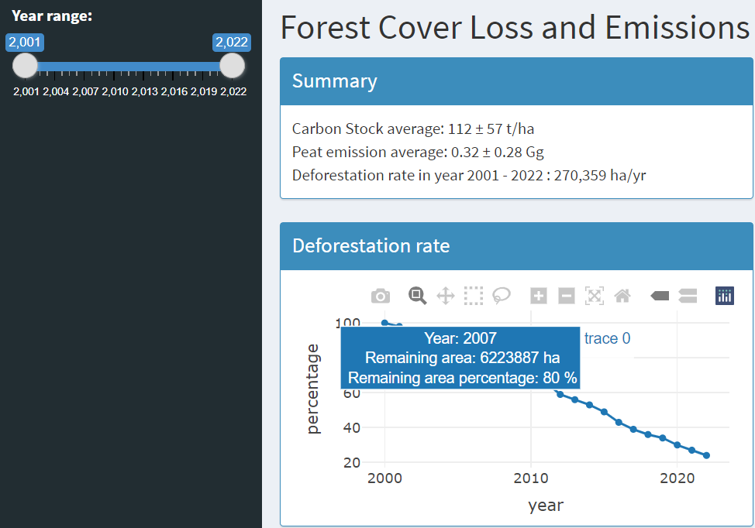
Summary
Summary of the information:
The average carbon stock was 112 ± 57 t/ha.
The average annual peat emission was 0.32 ± 0.28 Gg.
The forest cover loss rate from 2001 to 2022 was 270,359 ha/year.
Forest cover loss in 2007 was 6,223,887 ha.
The remaining forest in 2007 was 80% of the total area.

Slide 6
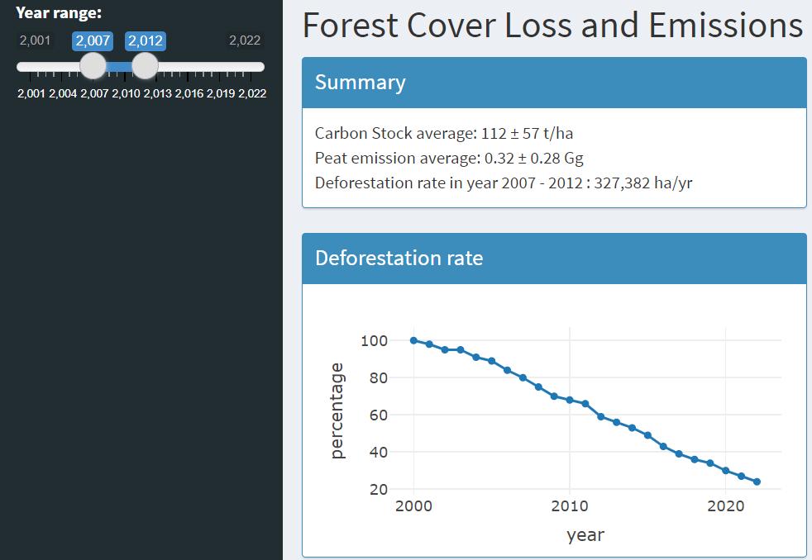
Forest cover loss rate
A reactive slider.
Set the slider to get a year range.
In this example, the slider is set to be in the year 2007 to 2012
Based on the reactive slider, the forest cover loss rate is computed.
The forest cover loss rate from 2007 to 2012 was 327,382 ha/year.

Slide 7
Data sources
Google Earth Engine:
UMD/hansen/global_forest_change_2022_v1_10
WCMC/biomass_carbon_density/v1_0/2010
FAO/GHG/1/DROSE_A

